Slide 1
Ergonomics
Smitty Chandler
JLab Occupational Medicine
6/3/09

Slide 2
Ergonomics
Rationale and Impact
Lifting Ergonomics
Principles
Technique
Office Ergonomics
Principles
Equipment

Slide 3
GOALS
Treat Injuries
Prevent Injuries
Enhance Happiness & Comfort
Increase Productivity

Slide 4
Principles of Ergonomics
Maximize time in neutral position
Minimize force exerted
Minimize unnatural posture
Minimize frequency of repetitious motion

Slide 5
Lifting Ergonomics
Spine anatomy and pathology
Principles of ergonomics
Torque
Safe lifting steps

Slide 6
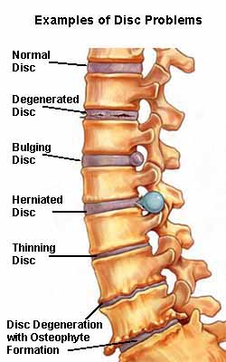
Causes of Back Pain

Slide 7
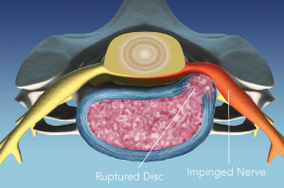
Degenerative Disc Disease

Slide 8
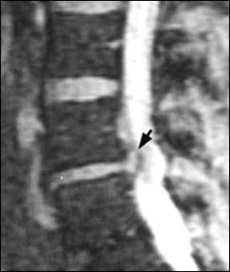
Degenerative Disc Disease

Slide 9
Degenerative Disc Disease

Slide 10
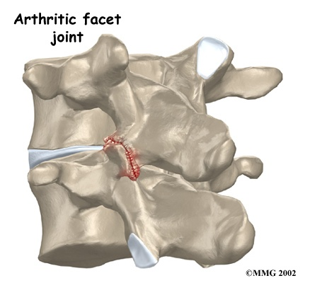
Degenerative Joint Disease

Slide 11
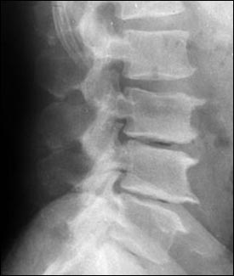
Degenerative Joint Disease

Slide 12
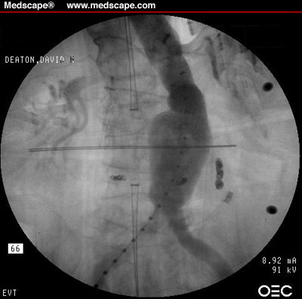
Abdominal Aortic Aneurysm

Slide 13
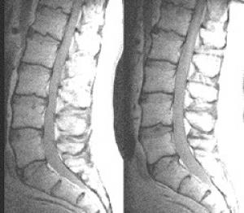
The Real Cause of Back Pain

Slide 14
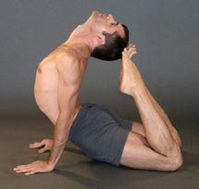
Safe Lifting

Slide 15
Torque
Torque = Force x Lever Arm
T = 100 lbs x 0 ft = 0 ft-lbs
T = 100 lbs x 1 ft = 100 ft-lbs
Lever Arm: 0 ft
Force: wt of upper body,100 lbs
Lever Arm: 1 ft
Force: wt of upper body, 100lbs

Slide 16
How to Minimize Torque
Minimize force
Lift less weight
Get help
Lift fewer items at a time
Minimize lever arm
Bend less
Use legs instead of back
Hold load as close as possible
Raise initial and terminal position of load

Slide 17
How Much Weight is OK?
It depends on
Past history
Size
Strength
How you feel
Structure of the load
For young, healthy, strong person, 50 lbs
For everyone, the less weight lifted and the less frequently, the better

Slide 18
Proper Lifting Steps
Lighten the load
Raise the load: Ideal load height is stomach level
Face the load
Place the load next to your body
Pretighten the abdominal and back muscles
Lift
Rotate body with feet to achieve terminal position
Never rotate torso
Never laterally flex
End lift at stomach level if possible

Slide 19
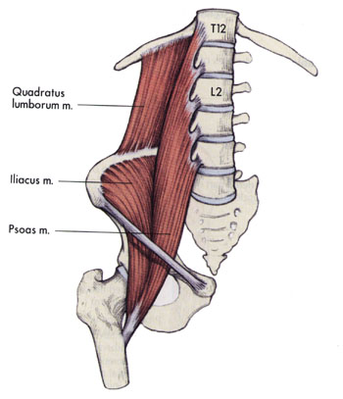
Pretighten Before Lifting

Slide 20
Office Ergonomics

Slide 21
NECK
Neutral position is angled downward
Top of monitor below eye level
Presbyopia

Slide 22
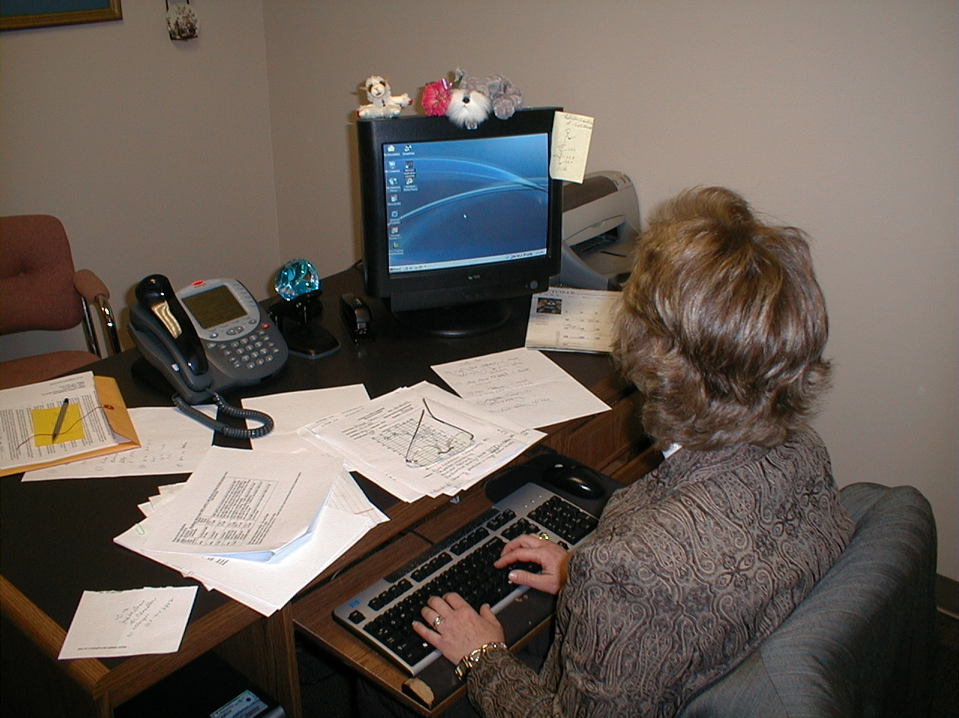

Slide 23
EYES
Set room light level to non-monitor endpoint
Reduce glare with shielding, not “bat caving”
Consider a monitor visor for glare
Antiglare screen if visor isn’t possible
Document holders

Slide 24
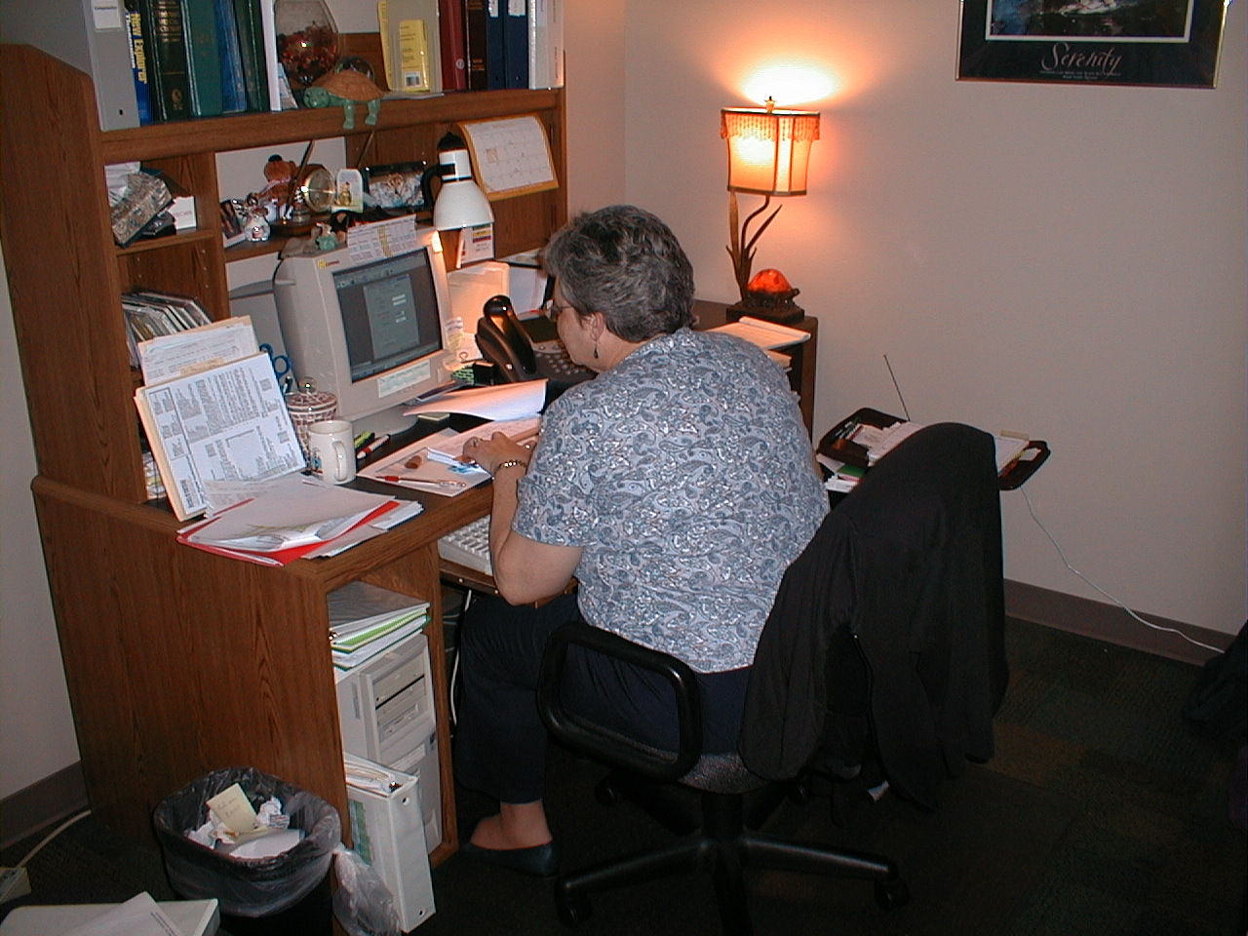

Slide 25
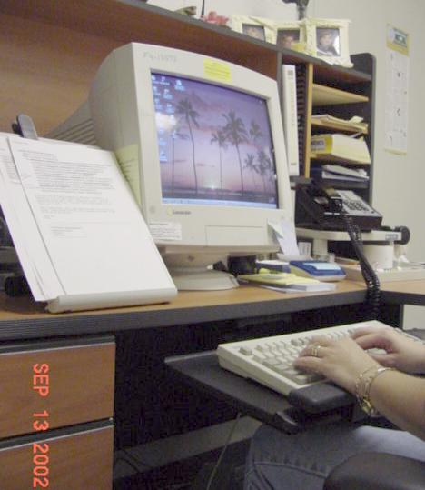

Slide 26
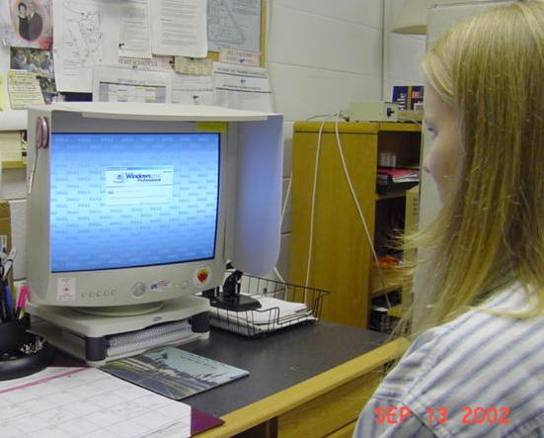

Slide 27
SHOULDERS & UPPER BACK
Keyboard low
Support forearms with chair arms
Requires correct chair
Good posture

Slide 28
KEYBOARDING
As low as possible
Avoid dorsiflexed wrists
Flatten keyboard feet
Down slope from elbow to fingers
Avoid pronation
Avoid external deviation at wrist
Ergonomically correct keyboards work well for touch typists, but not for sight typists

Slide 29
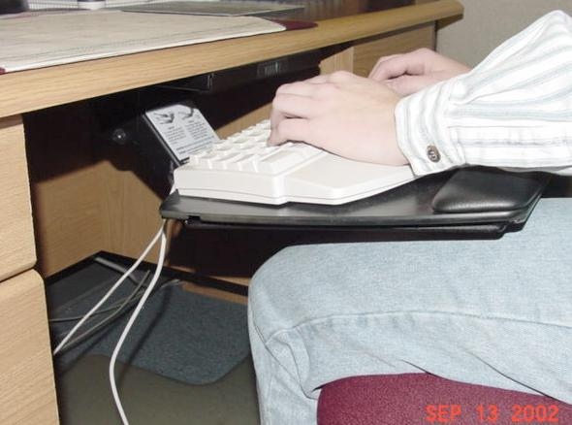

Slide 30
MOUSING
Adjacent to, and same plane as keyboard
Lap mousing if little keyboarding
Ergonomic mouse sometimes helps
Large trackball for specific problems
Foot mousing for severe problems

Slide 31
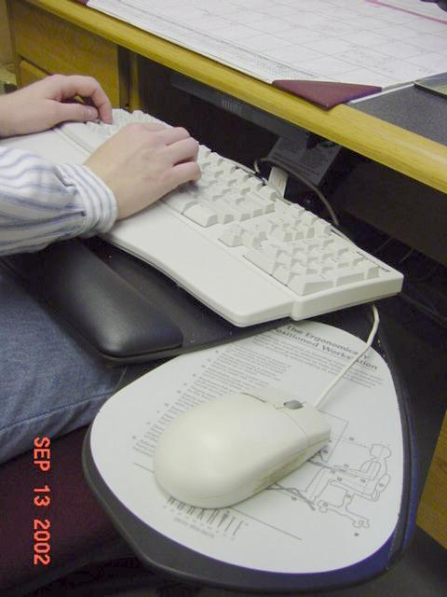

Slide 32
LOW BACK
Torque = force x lever arm
Good posture
Support lumbar lordosis
Vinyl floor mat
Do standing pelvic tilts
Foot rest if needed

Slide 33
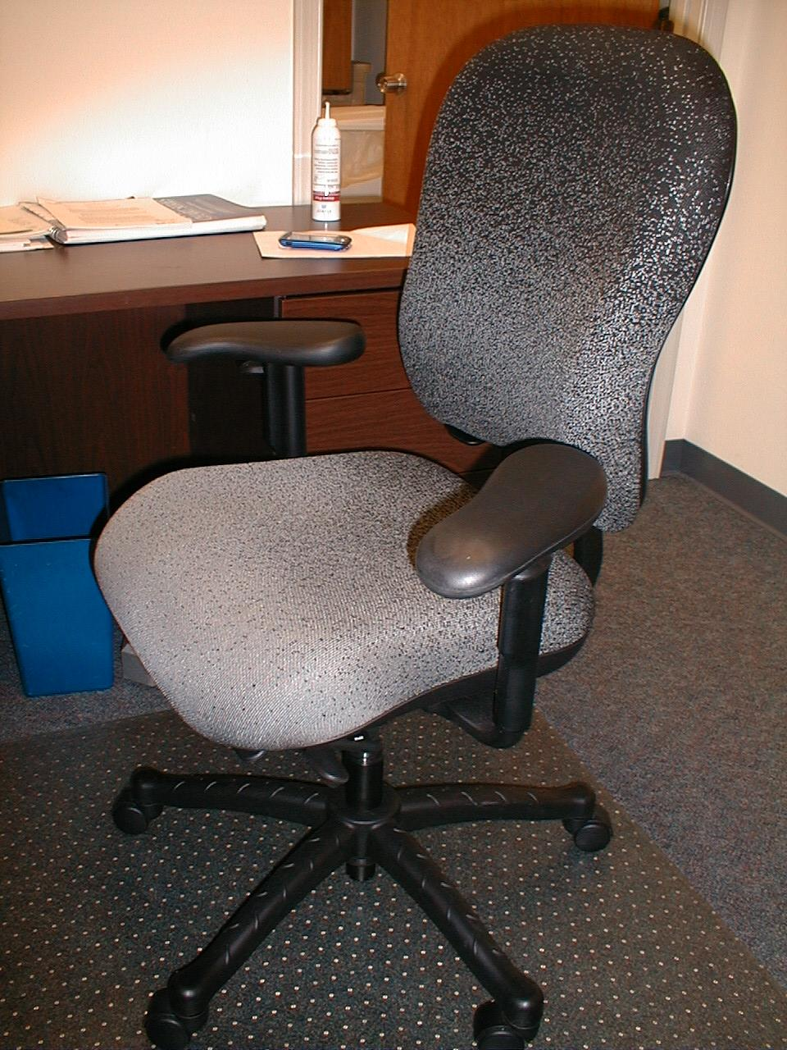
Knoll RPM Chair

Slide 34
Consultation Report
Thank you for meeting with me yesterday to discuss the ergonomic aspects of your office. The purpose of this email is to summarize my advice.
You should obtain an under the desk keyboard tray. I recommend the Workrite Banana Board with a 22 inch track, http://www.mcergo.com/mm5/merchant.mvc?Screen=PROD&Store_Code=MC&Product_Code=B-Combo&Category_Code=WorkRite-Keyboard-Platforms&gclid=CLr9-4_ynJUCFRJxxwodZhaOaw.
You should consider using an ergonomically correct keyboard such as the Microsoft Wireless Optical Desktop Pro, http://www.microsoft.com/hardware/mouseandkeyboard/productdetails.aspx?pid=010.
Your chair has many flaws. It would be helpful if you obtain a Knoll RPM chair with the sliding seat option. Please contact David Fazenbaker for ordering assistance.
You would benefit from an improved mouse. Please consider the Microsoft Natural Wireless Laser Mouse 6000, http://www.microsoft.com/hardware/mouseandkeyboard/productdetails.aspx?pid=010. If you prefer to scroll with your thumb, please let me know and I will give you other options.
You should obtain a vinyl floor mat.
Many office ergonomics items can be obtained from www.alimed.com.
It is important to properly adjust new equipment. Please let me know when your platform and chair arrive.
Again, thank you. -Smitty

Slide 35
Test!

Slide 38
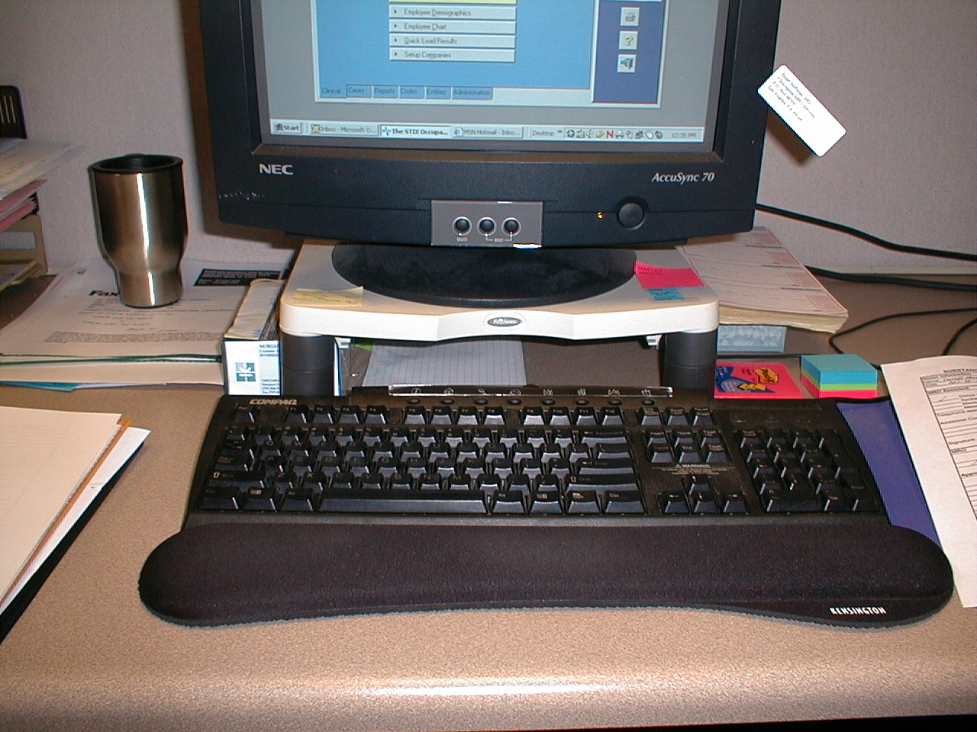

Slide 39
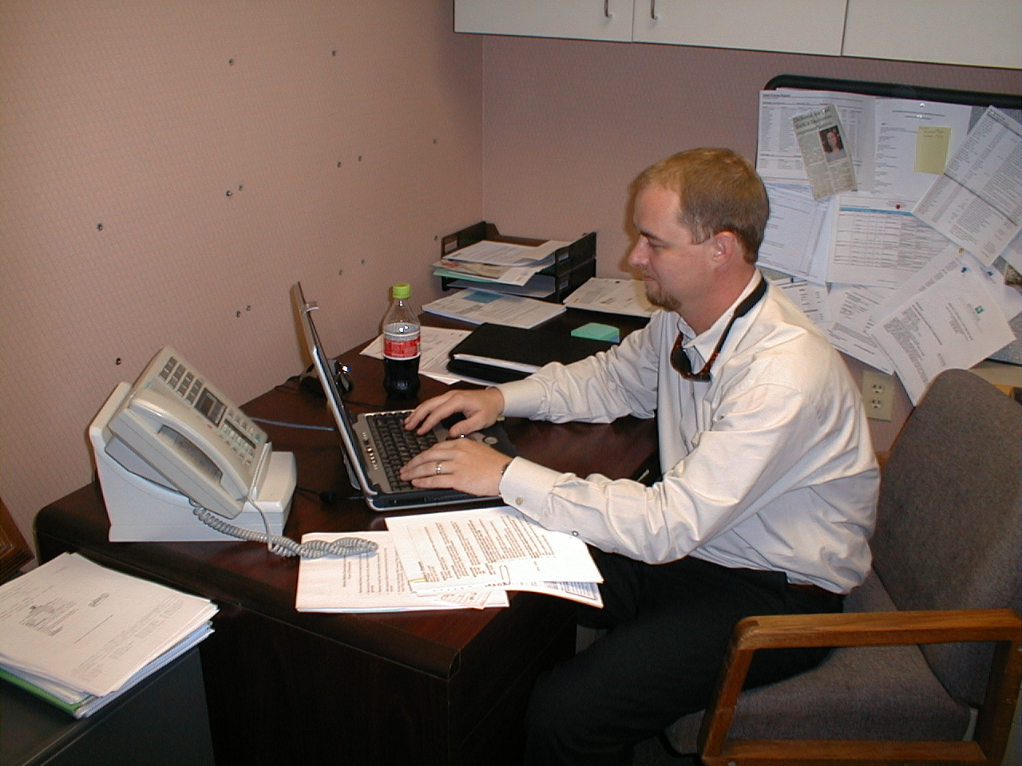

Slide 40
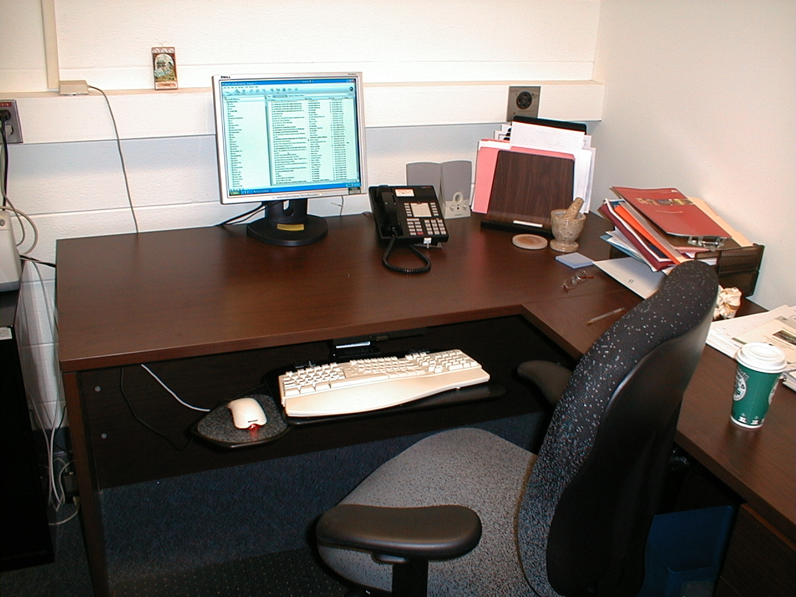

Slide 41
Thank You!
Smitty Chandler
chandler@jlab.org

